Slide 1
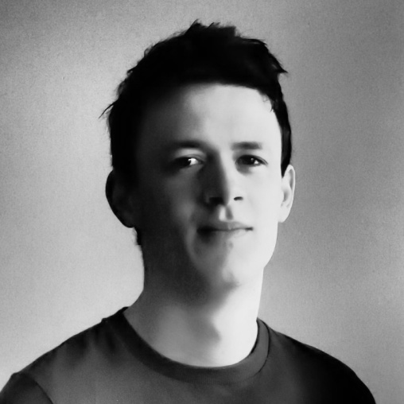
Ruaidhri Molloy portfolio
Software Engineer
Dublin, Ireland
Linkedin
rmolloy10@gmail.com
Github

Slide 2
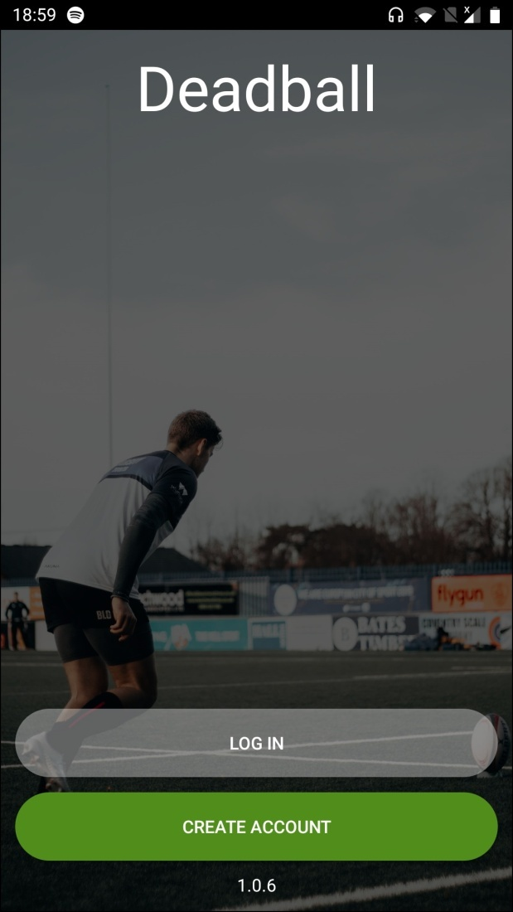



Deadball
Personal Side Project
Platform: Android (Kotlin)
Date: 2022
Role: Sole Developer – From Scratch
Sports analytics app to create shot maps for players and teams to see what areas of the field need improvement. Supports rugby, football, American football, gaelic football and hurling

Slide 3
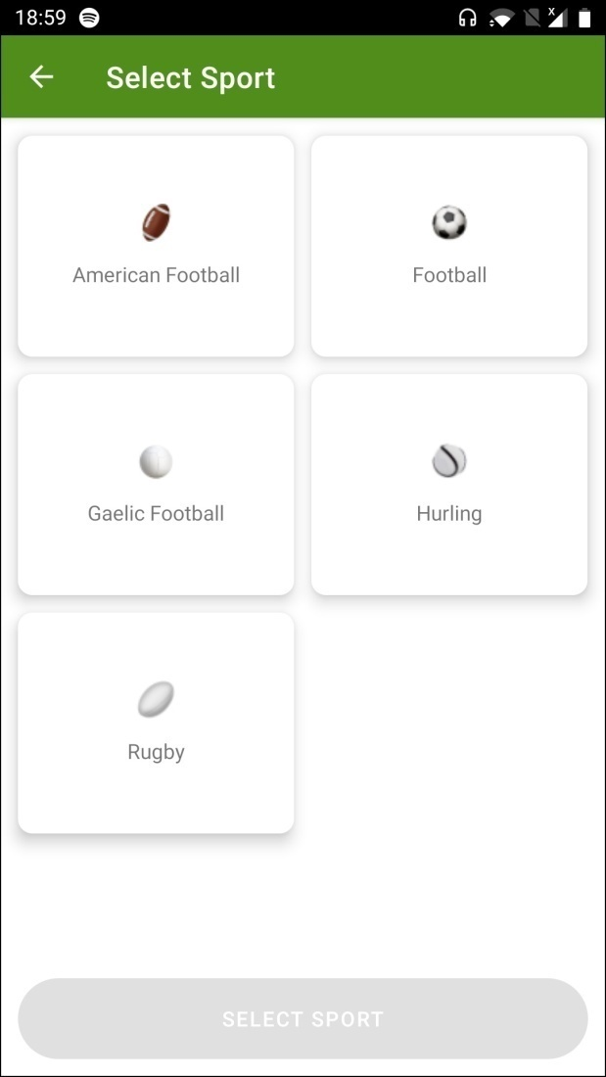
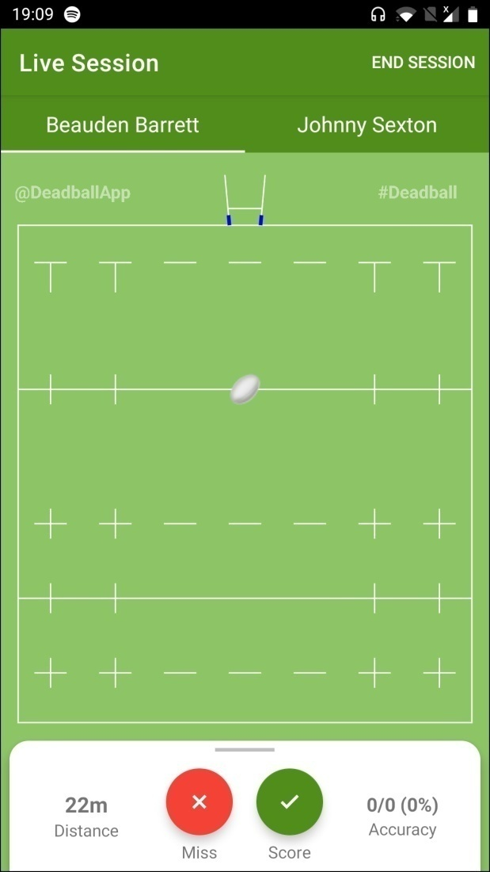
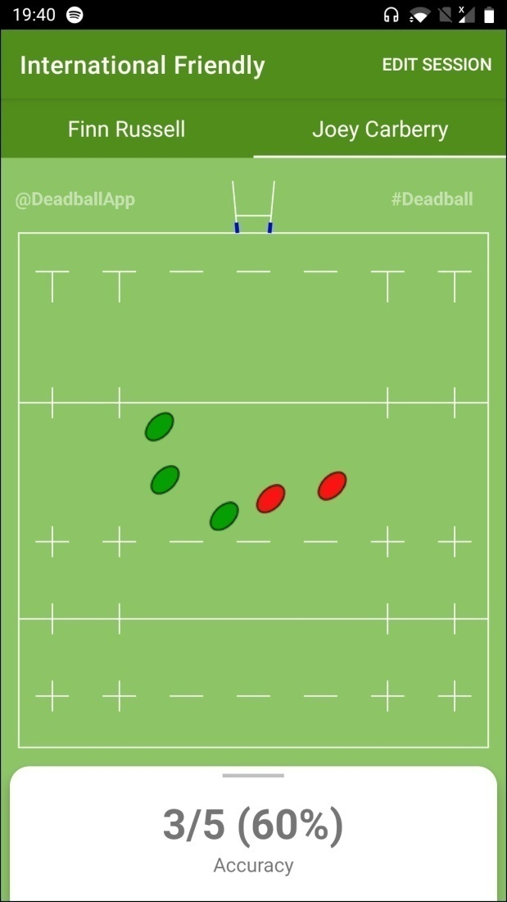

Slide 4
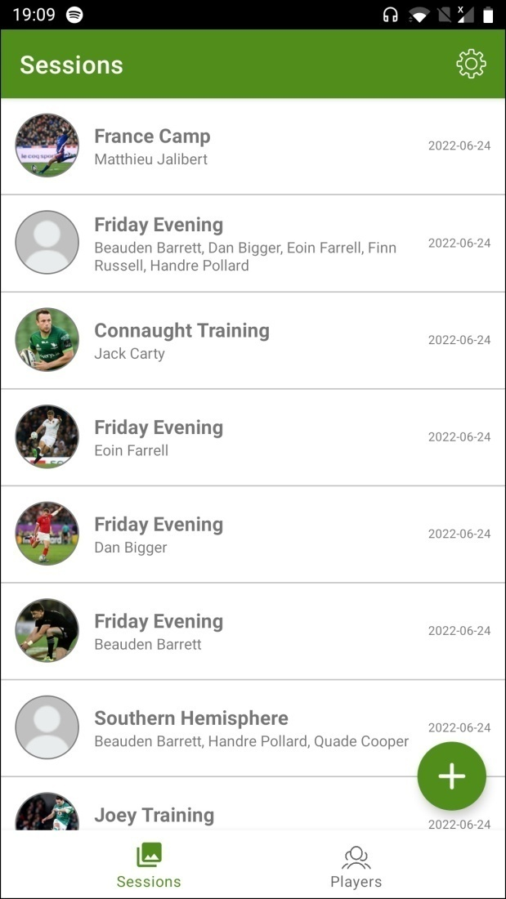
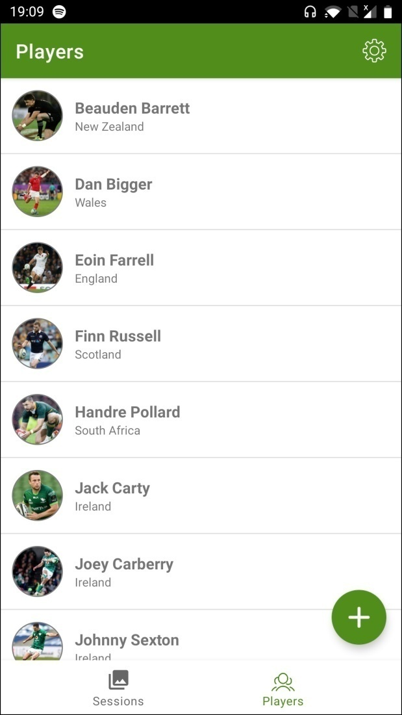
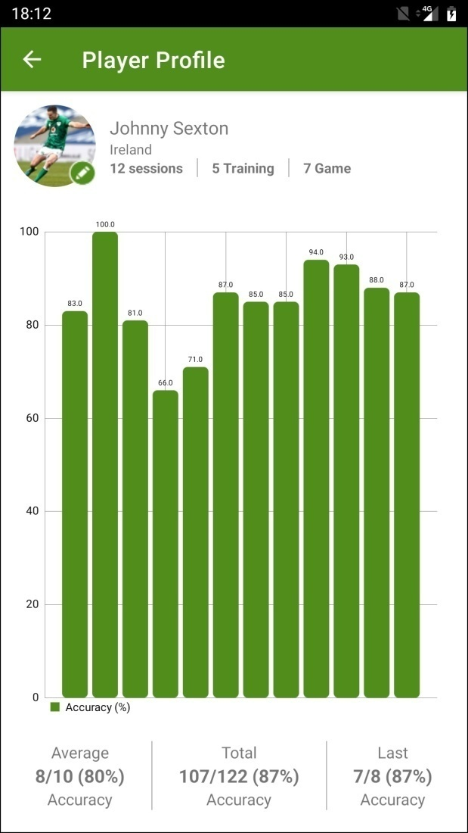

Slide 5
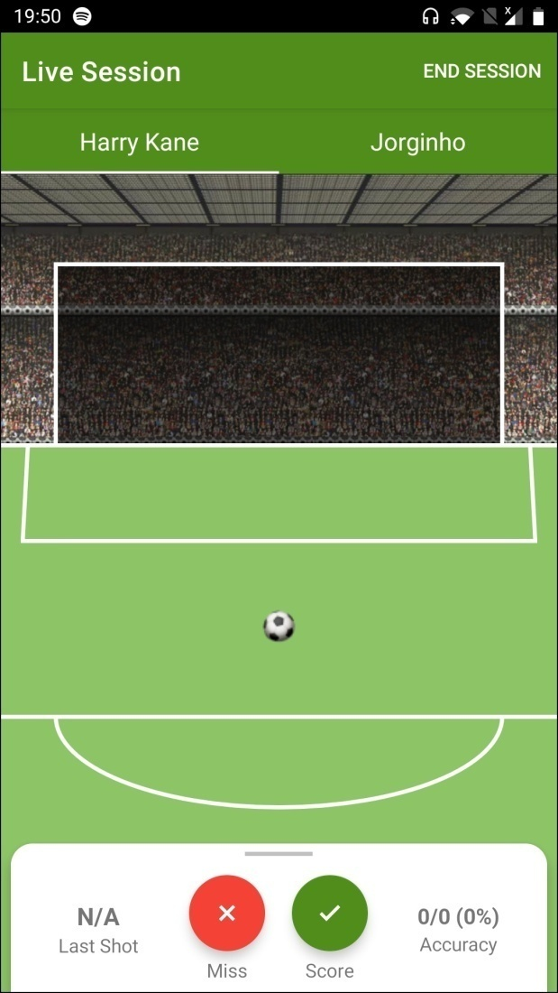
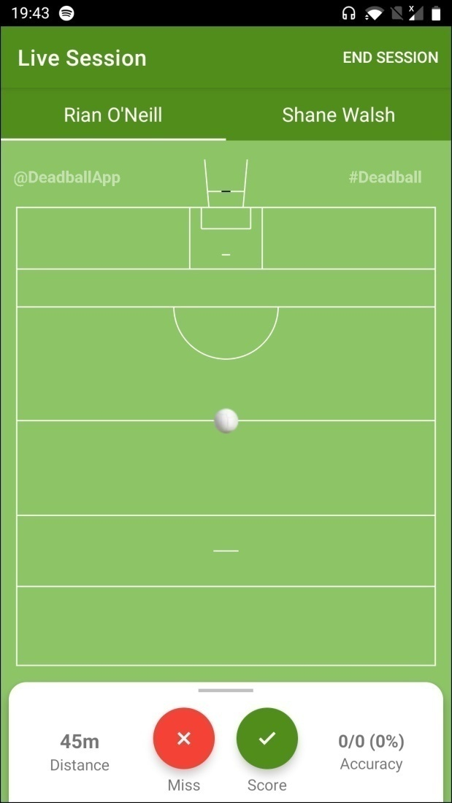
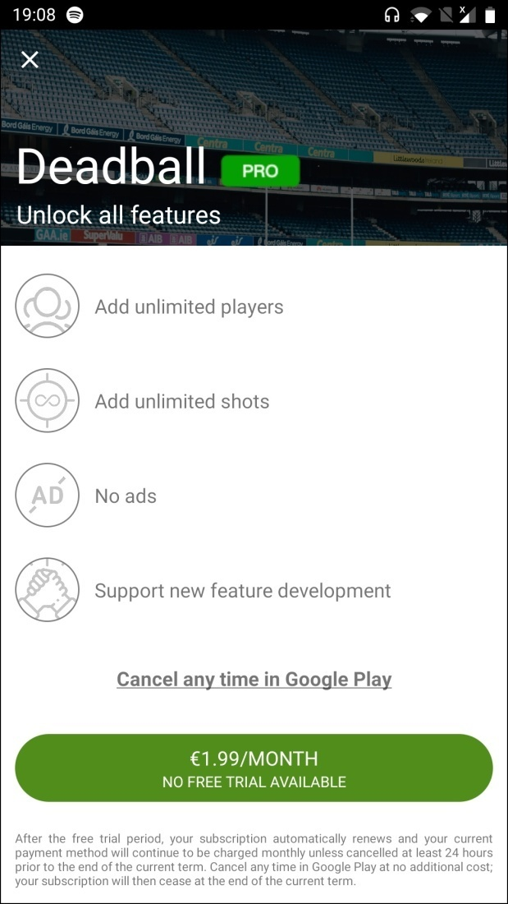

Slide 6
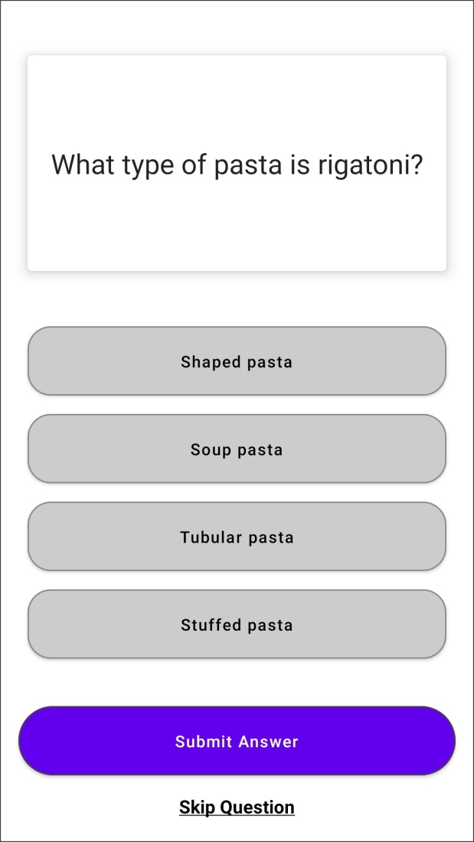
Daily Doozy
Personal Side Project
Platform: Android (Kotlin)
Date: 2022
Role: Sole Developer – From Scratch
Multi-choice trivia app

Slide 7
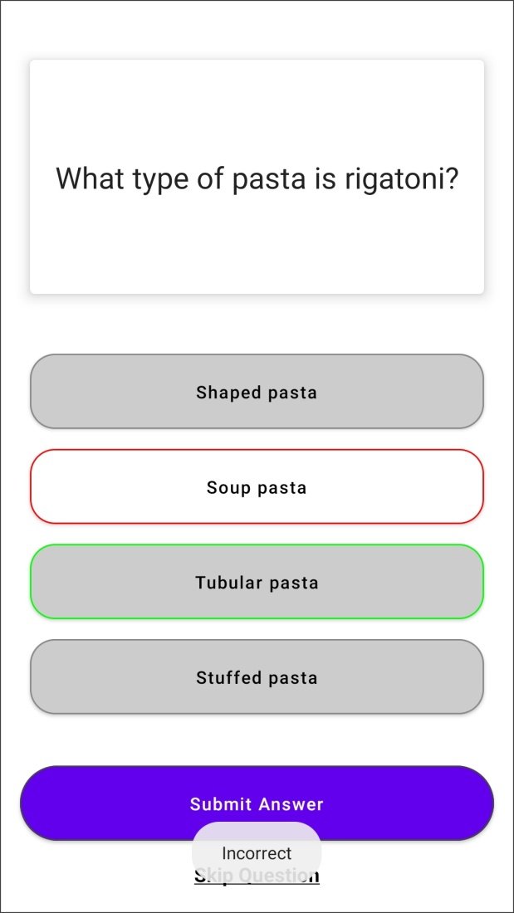
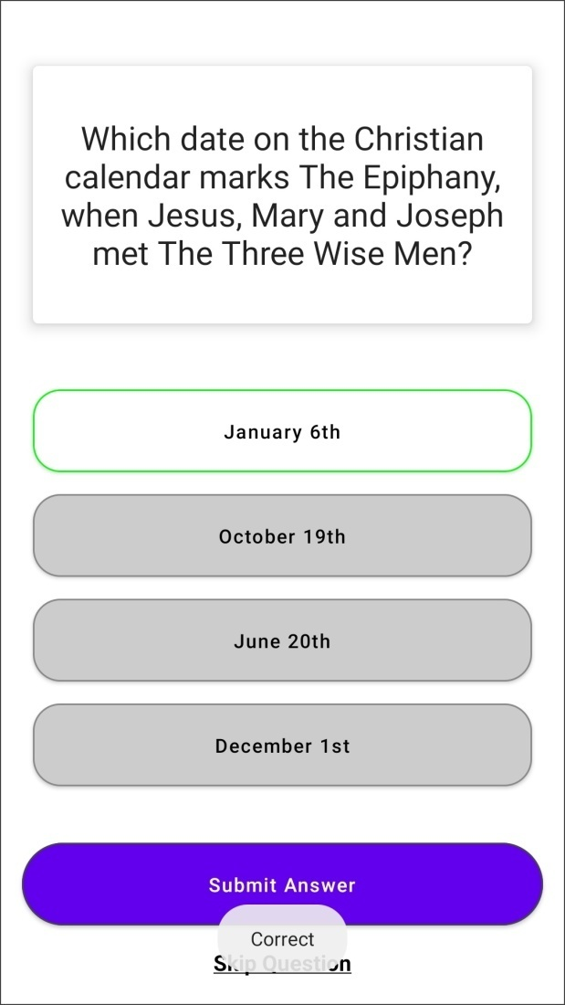

Slide 8

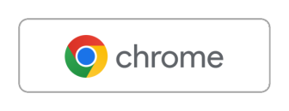
Verisense
LID Monitor
Developed at: Shimmer Research
Platform: Windows (Java)
Date: 2019-2022
Role: Contributor (Cloud)
Wearable sensing platform designed specifically for clinical trials

Slide 9
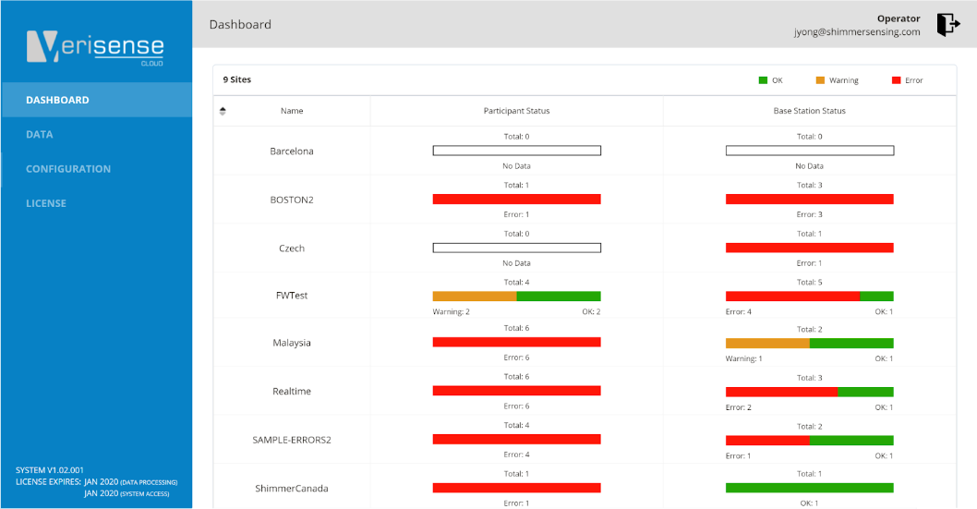
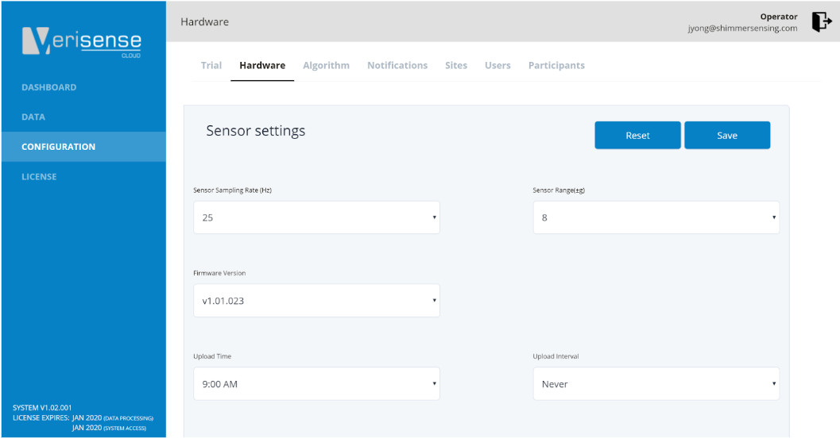
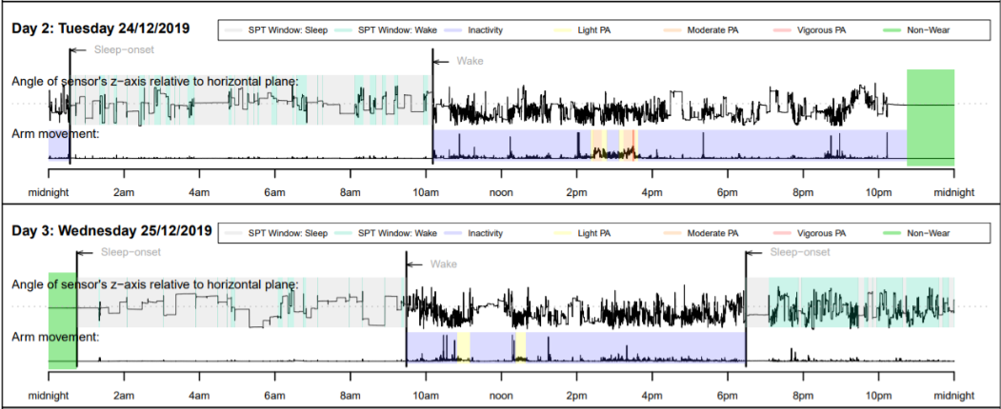

Slide 10
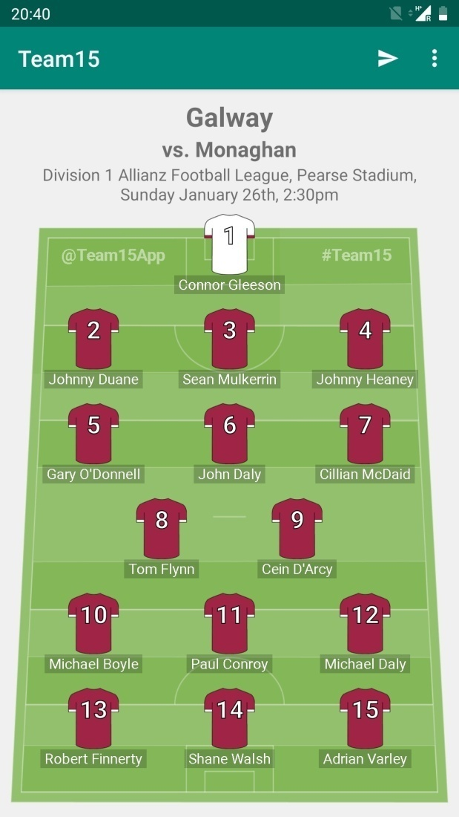
Team15
Personal Side Project
Platform: Android (Kotlin)
Date: 2019
Role: Sole Developer – From Scratch
Gaelic football/hurling team builder app to share selection on game-day via social media

Slide 11
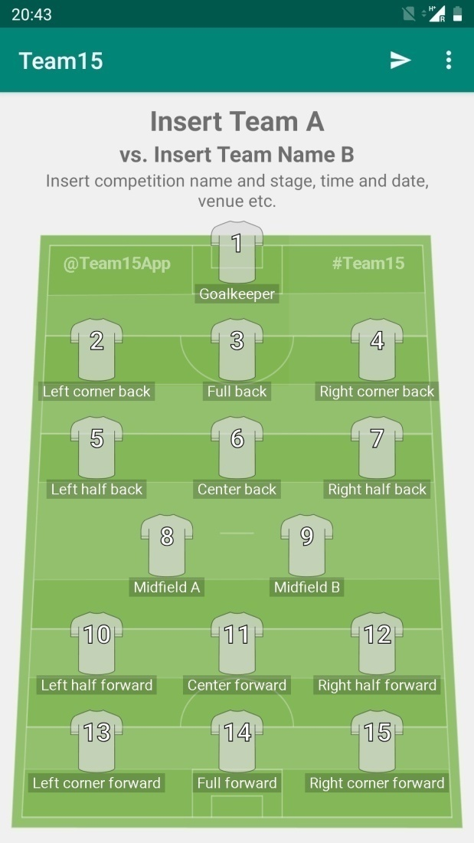
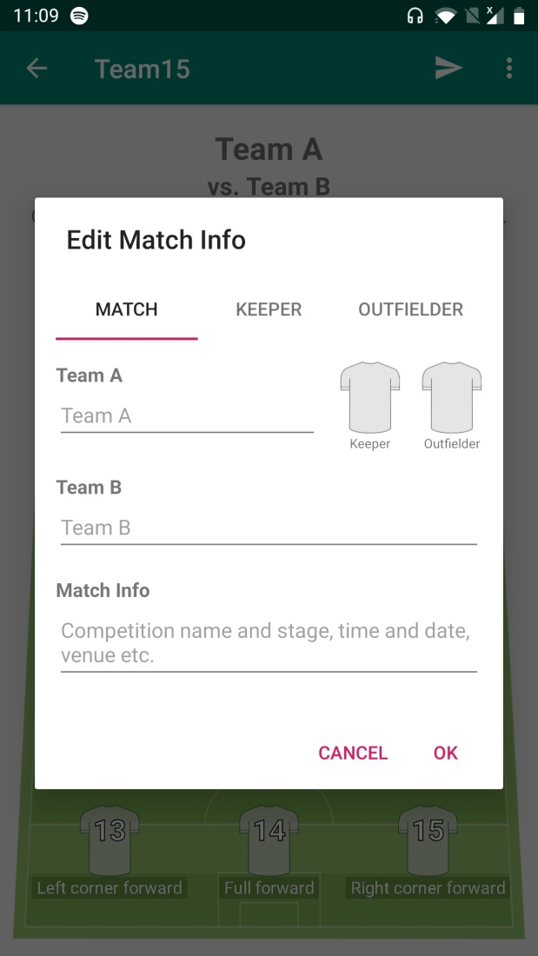
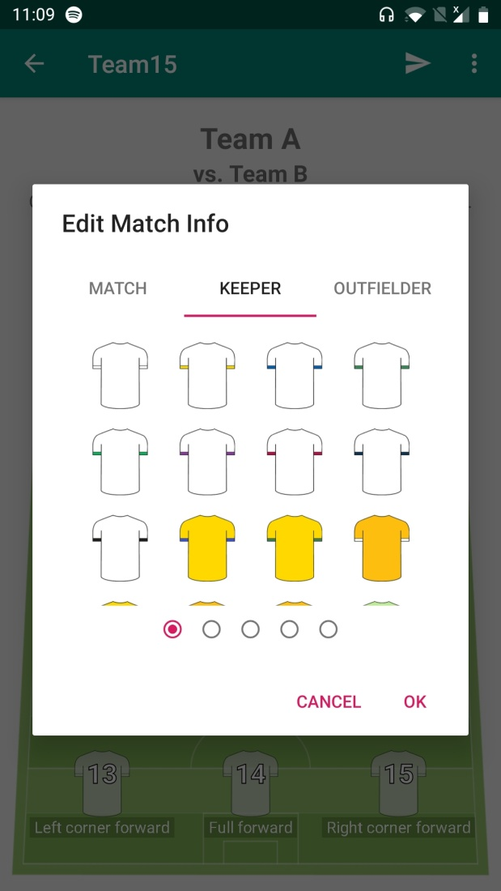

Slide 12
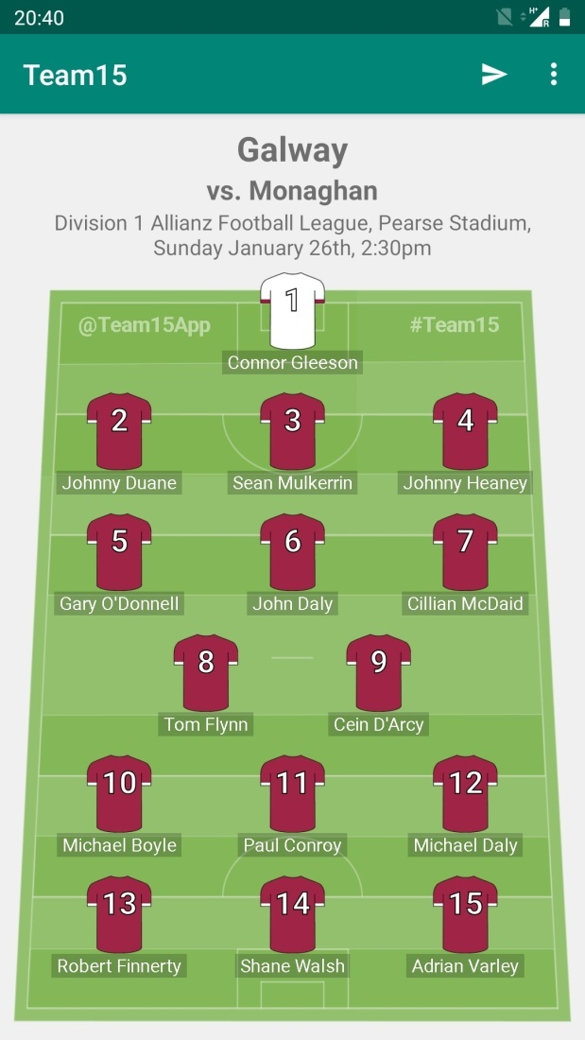
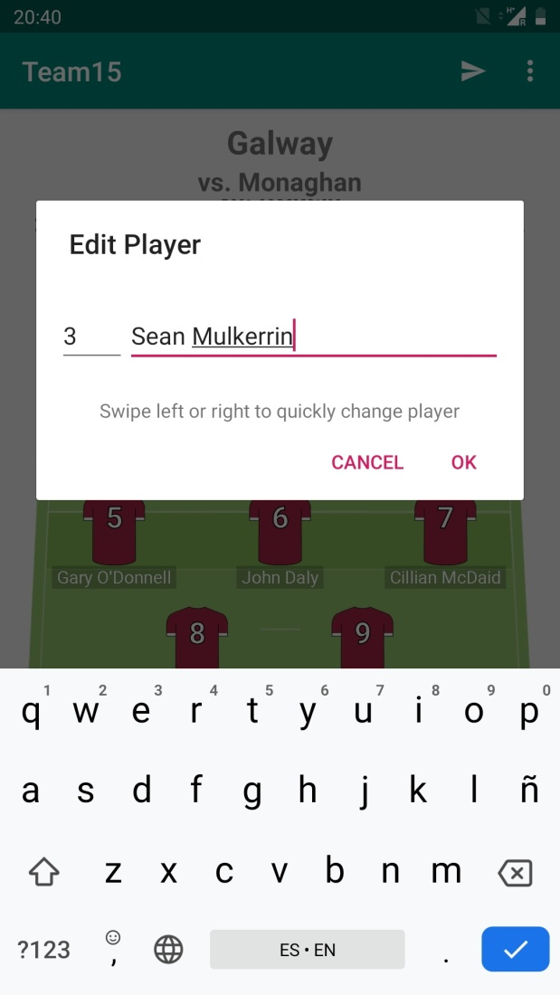
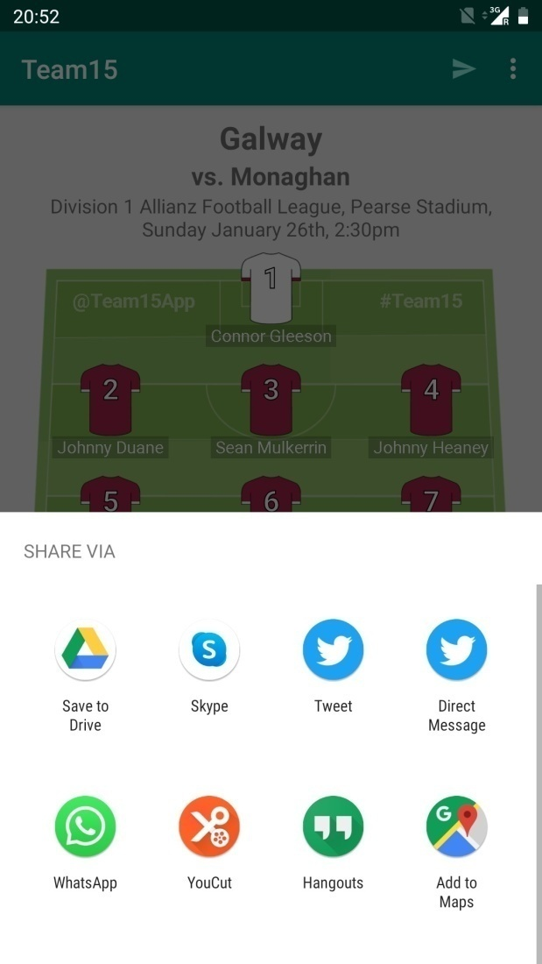

Slide 13
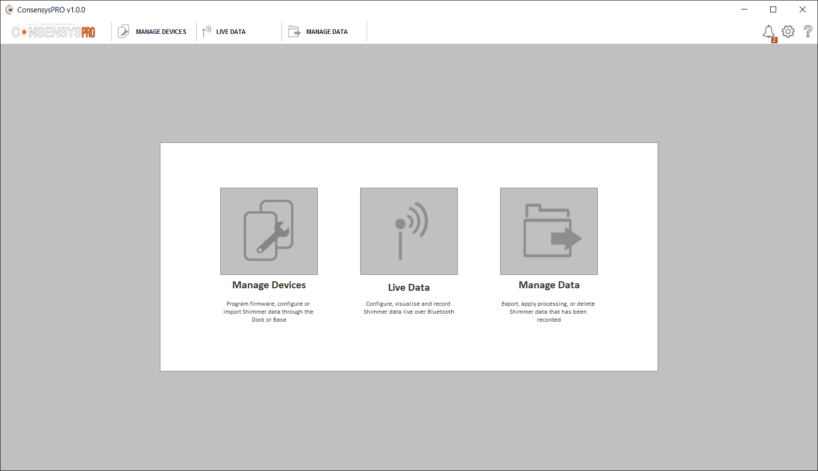
NeuroLynQ
LID Monitor
Developed at: Shimmer Research
Platform: Windows (Java)
Date: 2018
Role: Contributor
App to measure the emotional response of a group of up to 45+ people simultaneously through use of GSR and PPG sensor

Slide 14
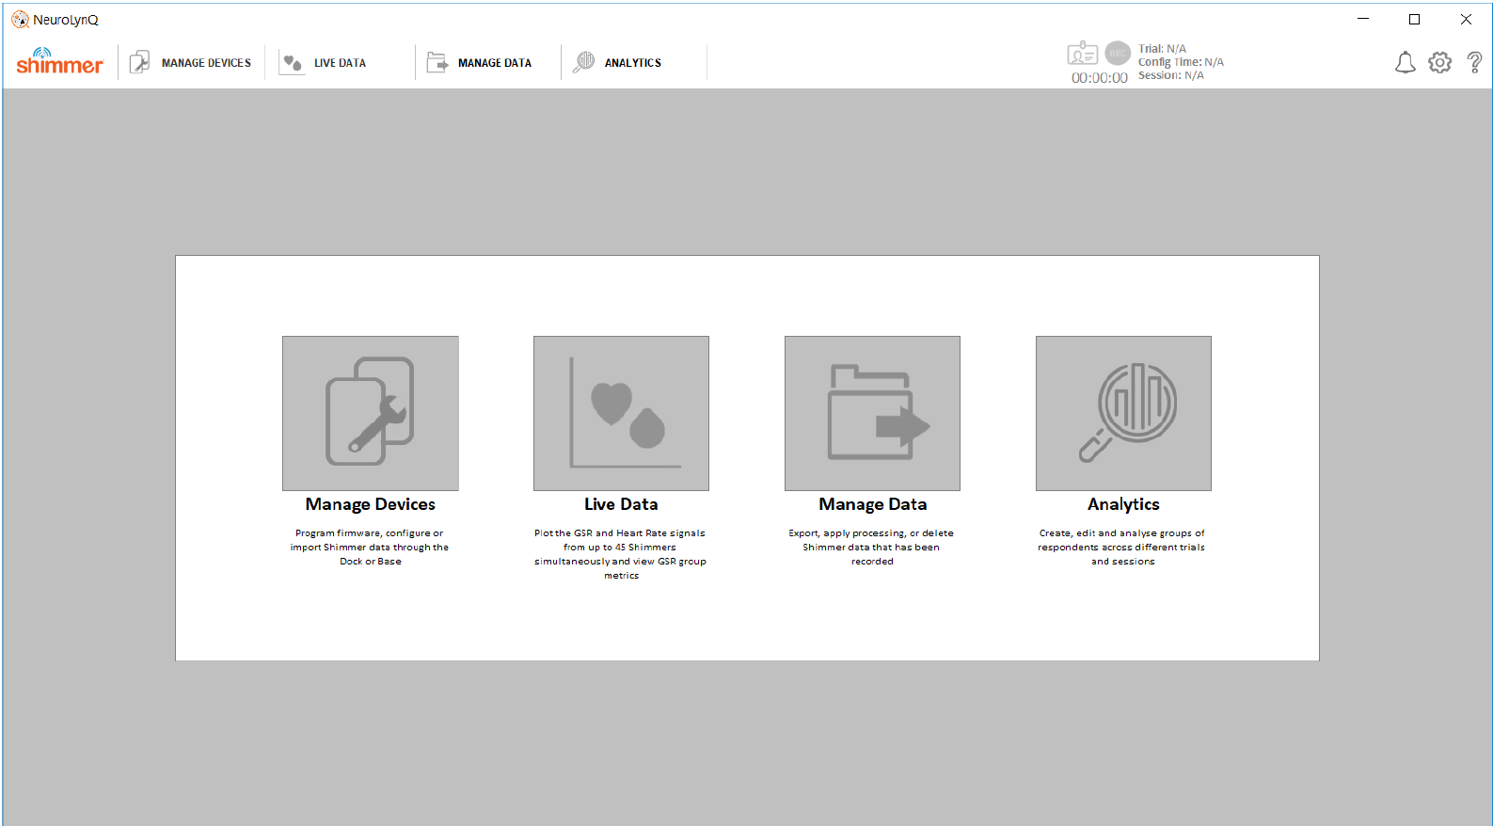
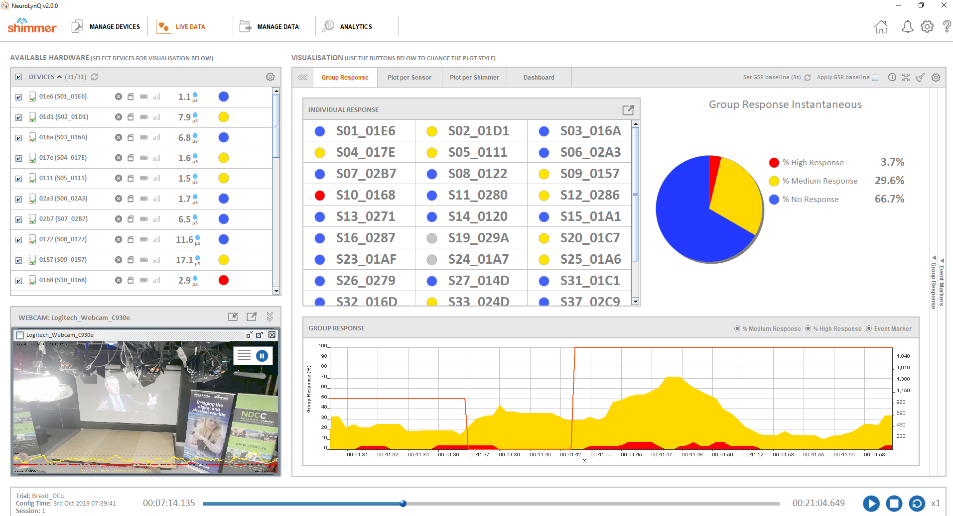
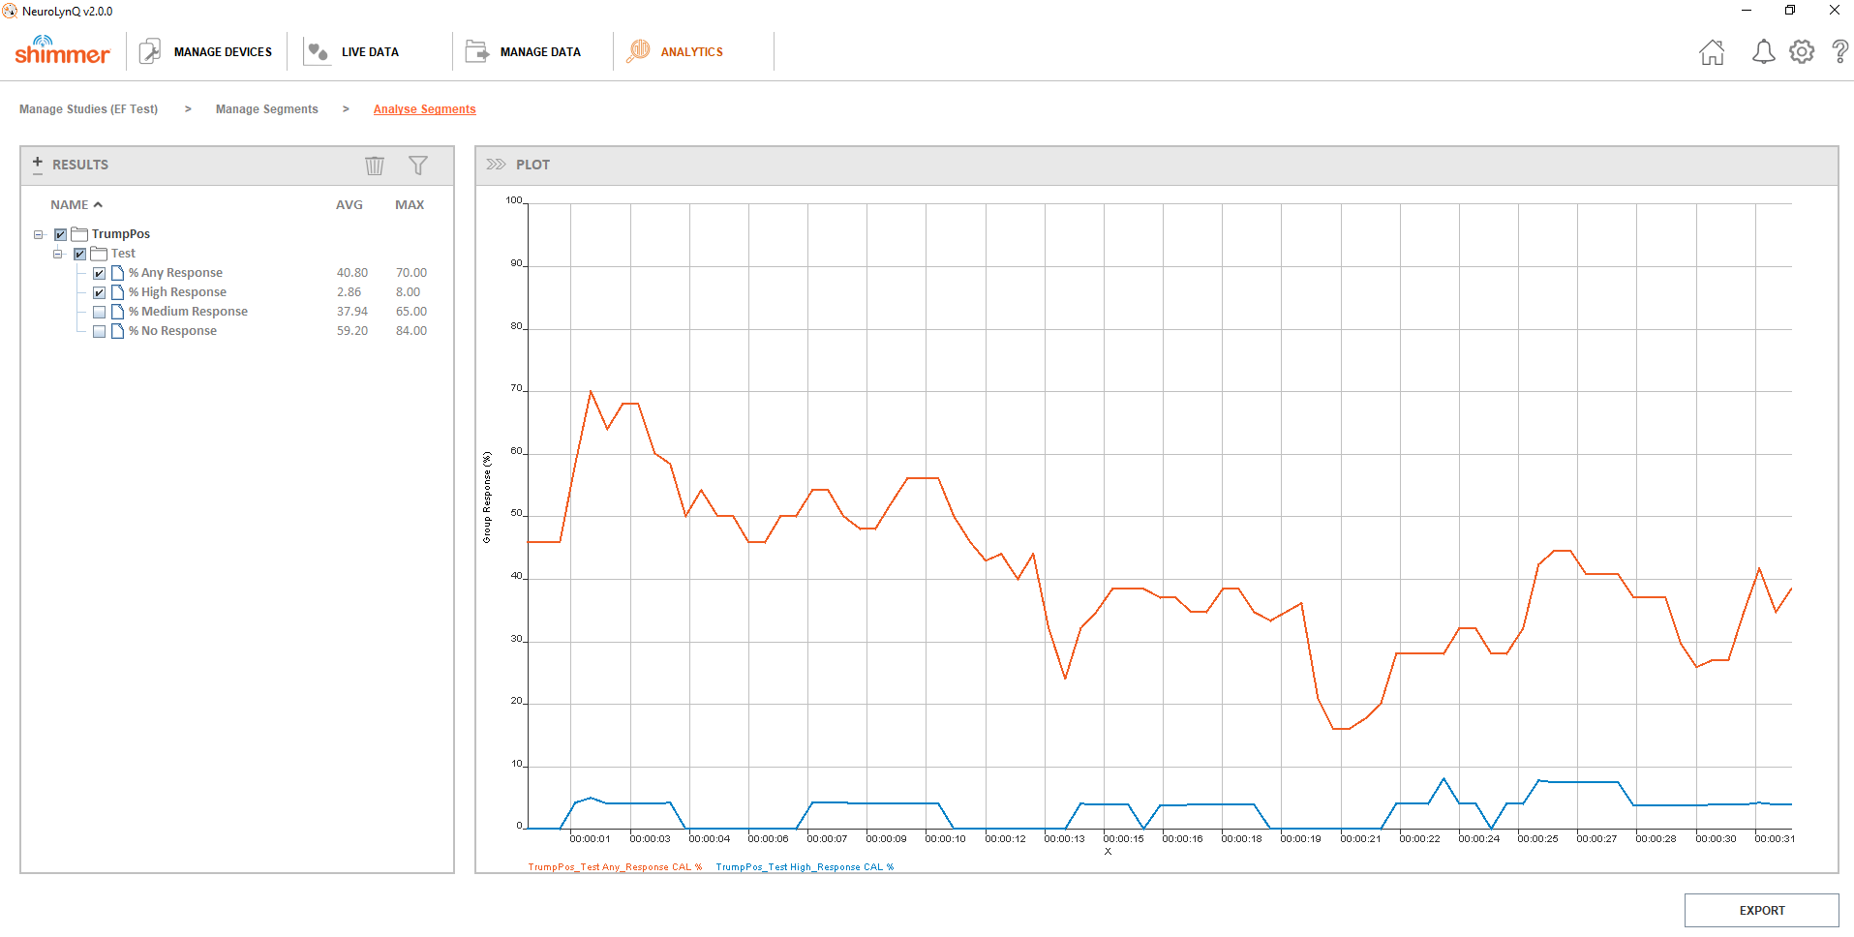

Slide 15

Fusion – CIMIT
LID Monitor
Developed at: Shimmer Research
Platform: Windows (Java)
Date: 2017
Role: Co-Lead Developer
App to assist clinicians with implant of a Cardiac Resynchronization Therapy (CRT) device and with periodic therapy titration using a single ECG sensor.

Slide 16
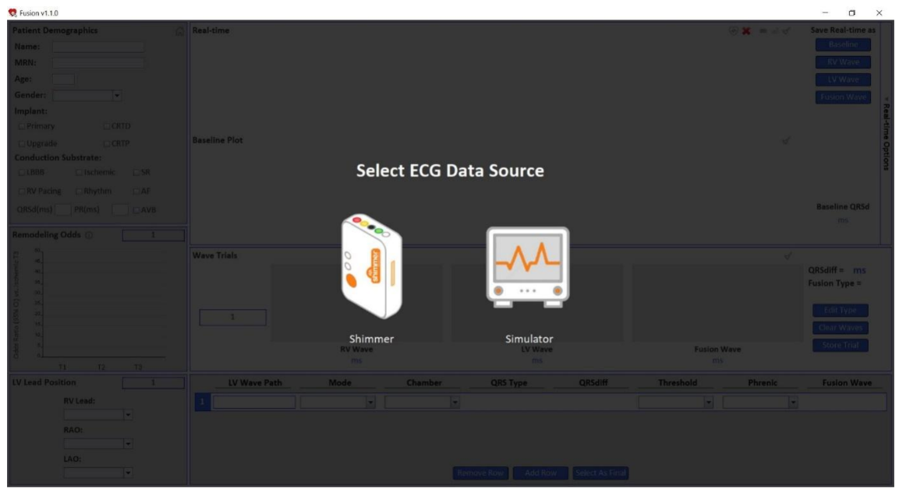
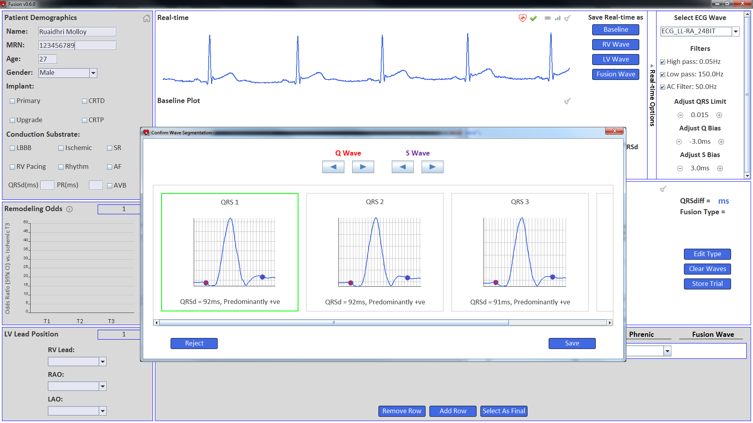

Slide 17
Consensys
LID Monitor
Developed at: Shimmer Research
Platform: Windows (Java)
Date: 2016
Role: Contributor
All-in-one multi Shimmer sensor management software supporting firmware updates, configuration, data collection, storage and processing

Slide 18
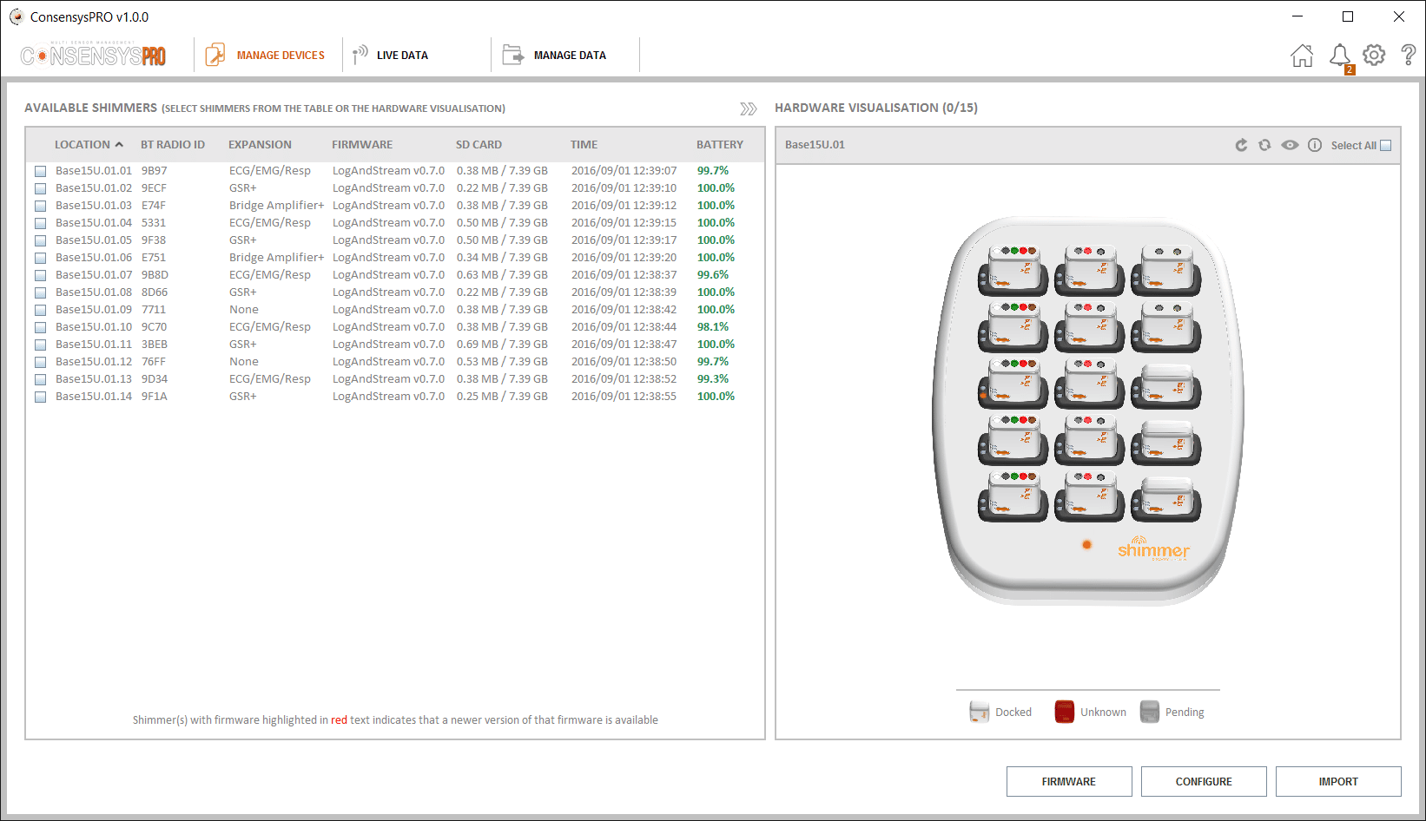
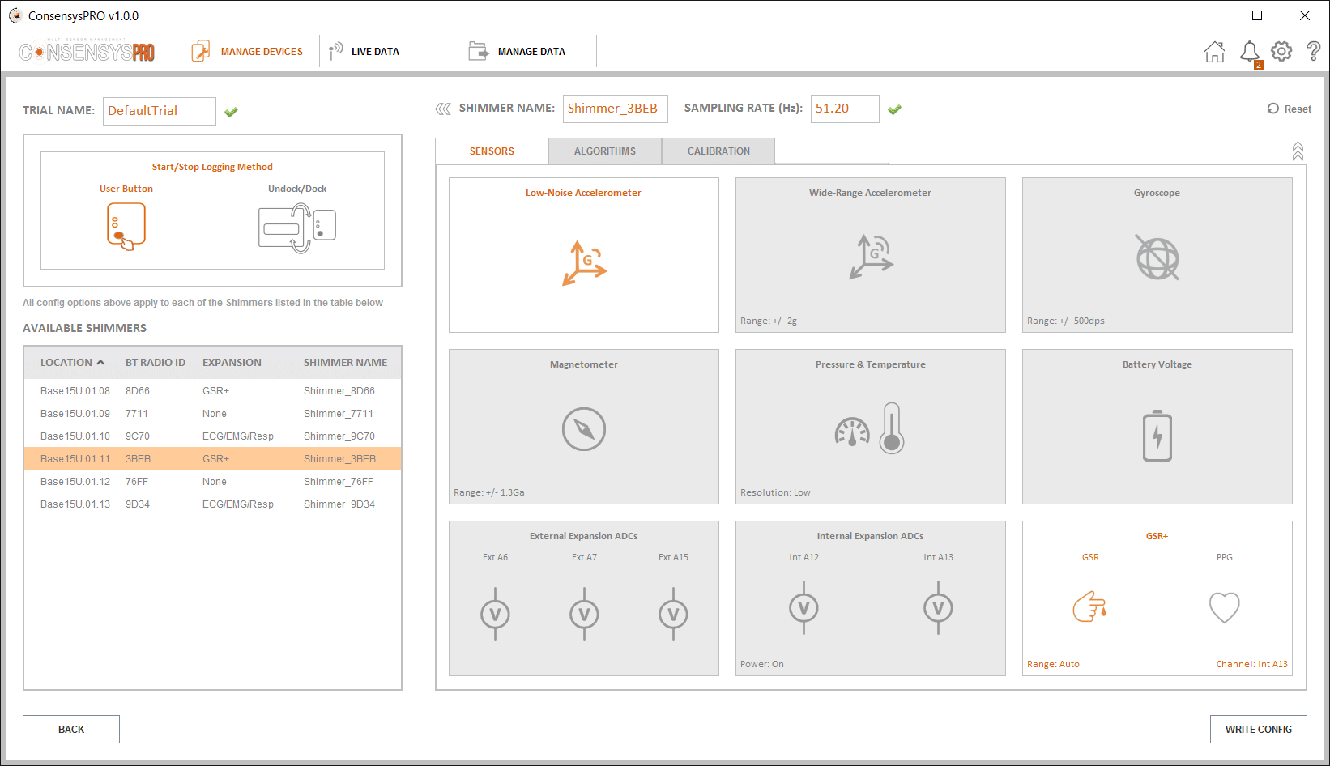
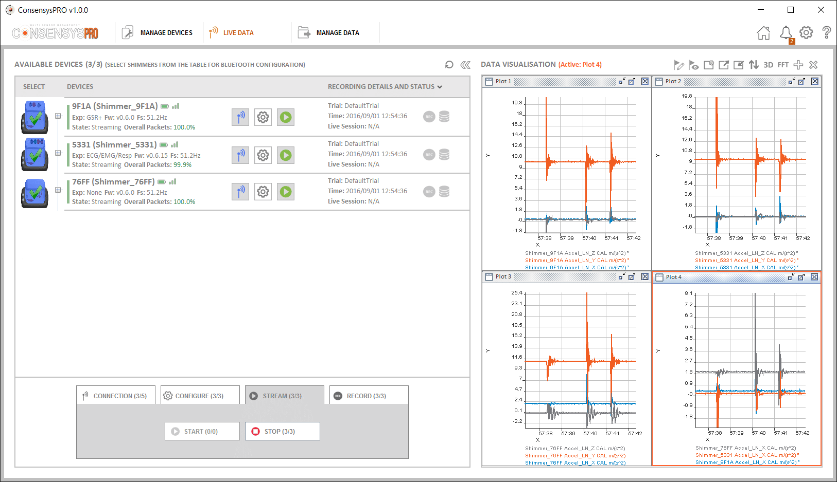

Slide 19

LID Monitor - ClearSky
LID Monitor
Developed at: Shimmer Research
Platform: Windows (Java)
Date: 2015
Role: Co-Lead Developer
App to monitor the side effects of medication for Parkinson’s sufferers using six IMU sensors

Slide 20
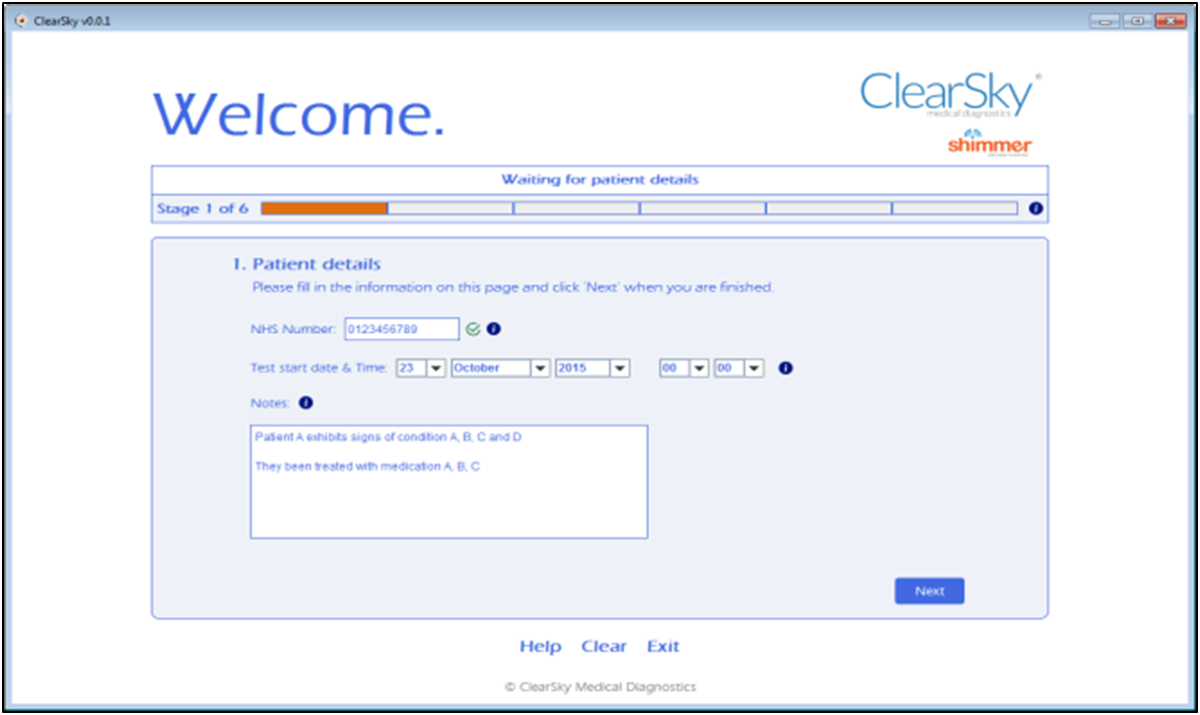
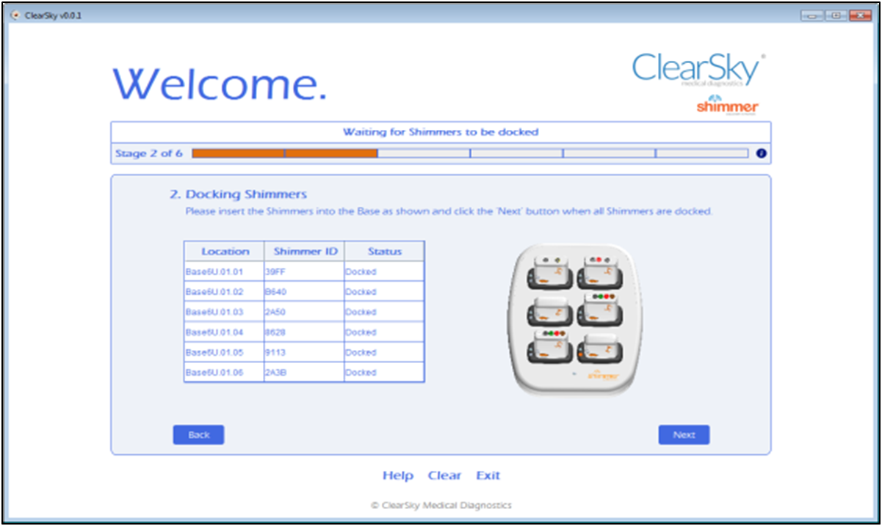
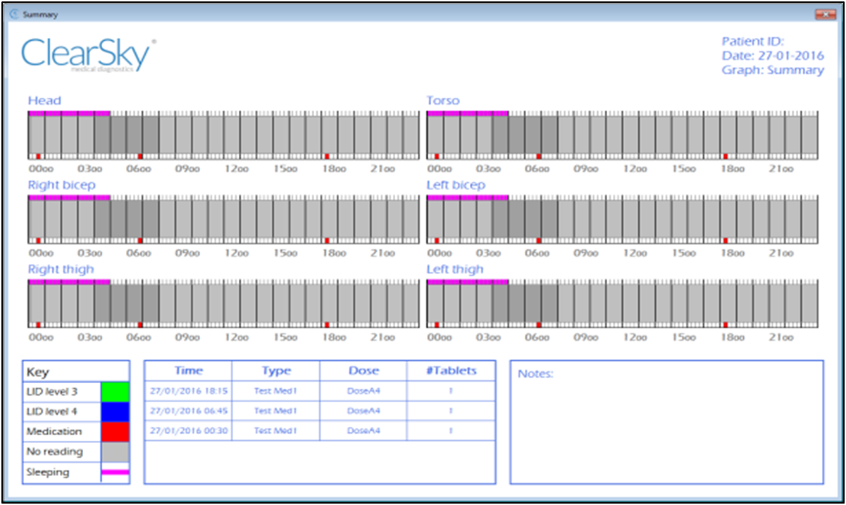

Slide 21
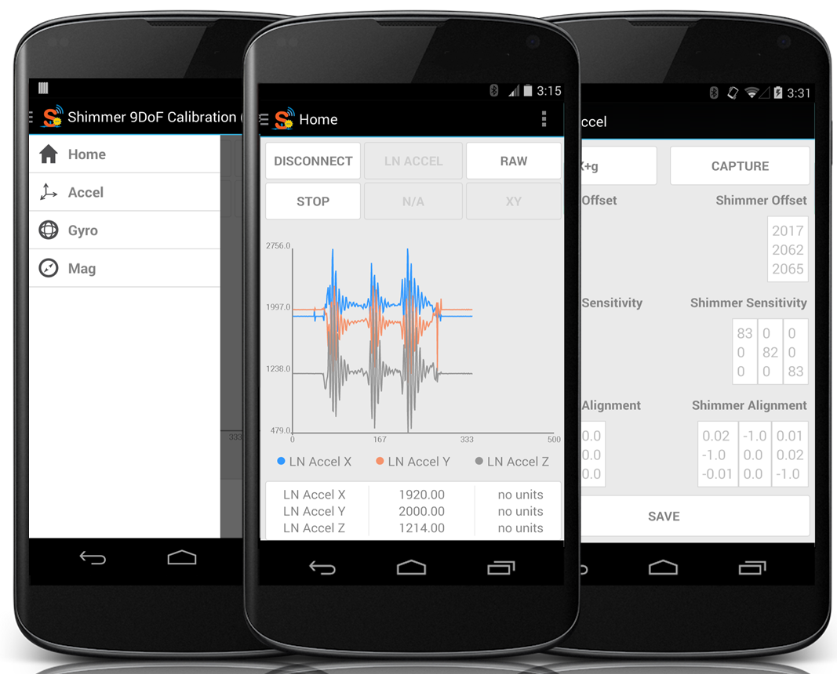
9DoF Calibration
Developed at: Shimmer Research
Platform: Android
Date: 2015
Role: Sole Developer – From Scratch
Automated procedure for calculating the calibration parameters for a tri-axial accelerometer, gyroscope and magnetometer

Slide 22
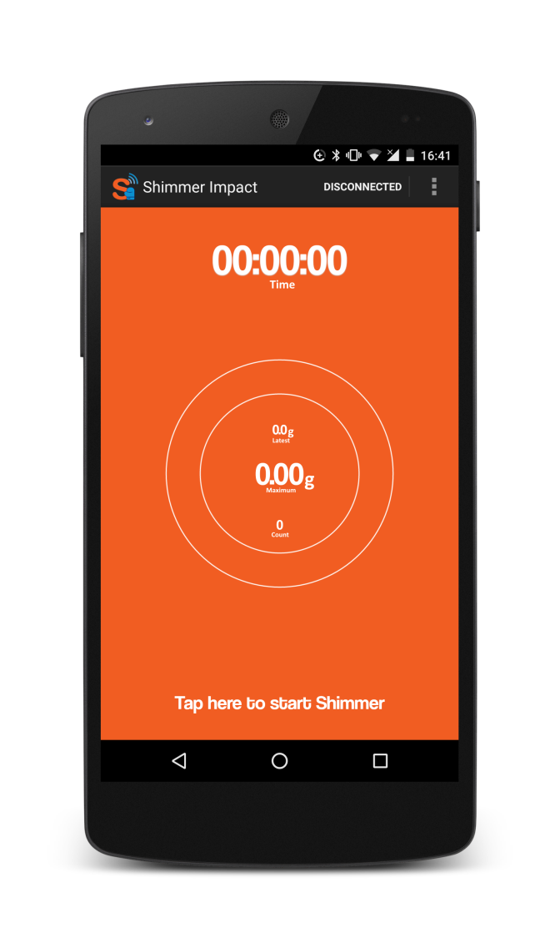
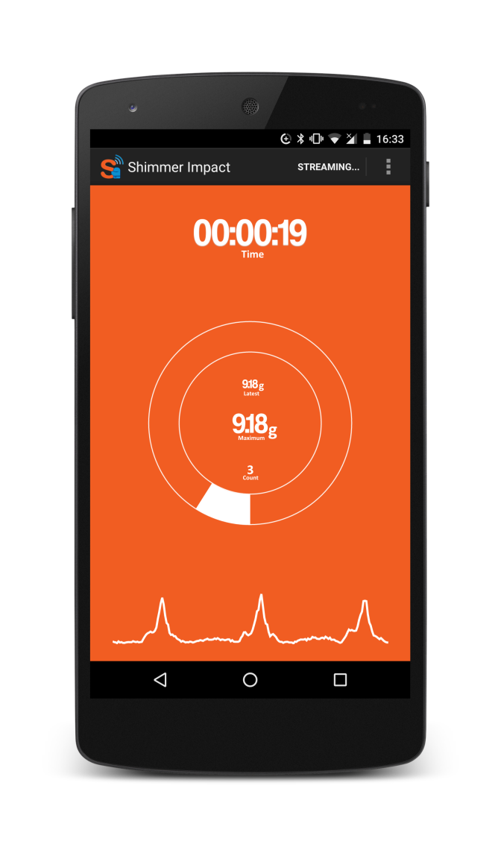
Shimmer Impact
Developed at: Shimmer Research
Platform: Android
Date: 2014
Role: Sole Developer – From Scratch
App to record high impact events using the Shimmer3 200g accelerometer for tackle bag drills in sports such as rugby and American football

Slide 23
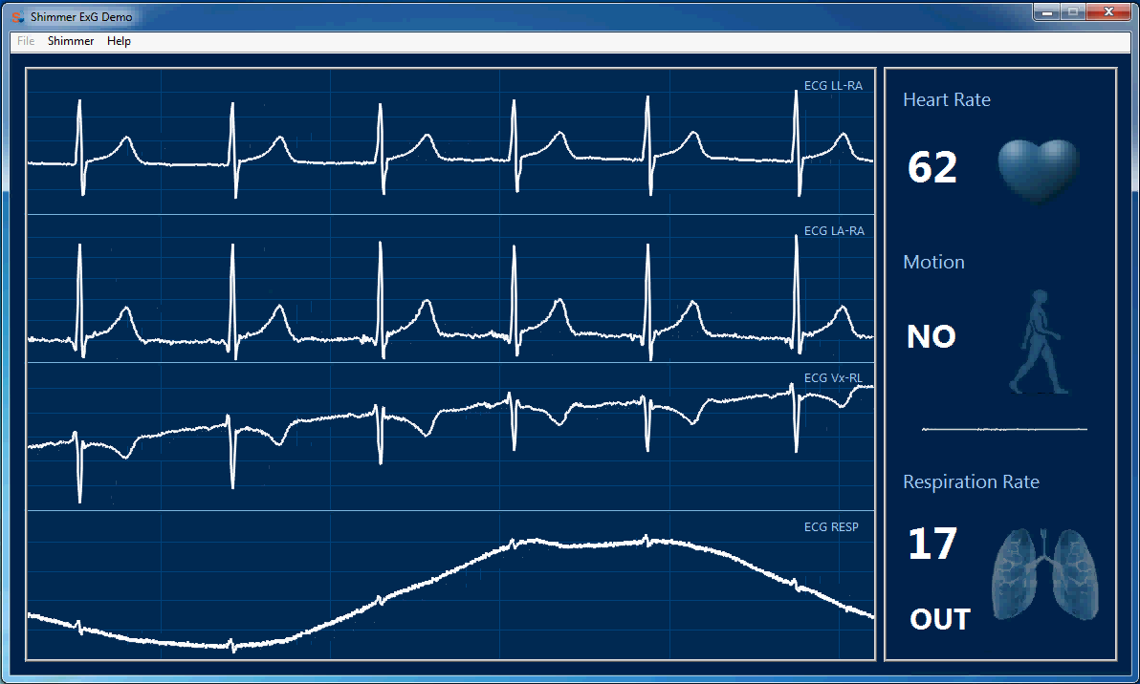
Shimmer ECG Demo
Developed at: Shimmer Research
Platform: Windows (LabVIEW)
Date: 2014
Role: Sole Developer – From Scratch
Marketing demo utilizing accelerometer, ECG, and respiration sensor with respective motion, heart rate and respiration rate algorithms

Slide 24
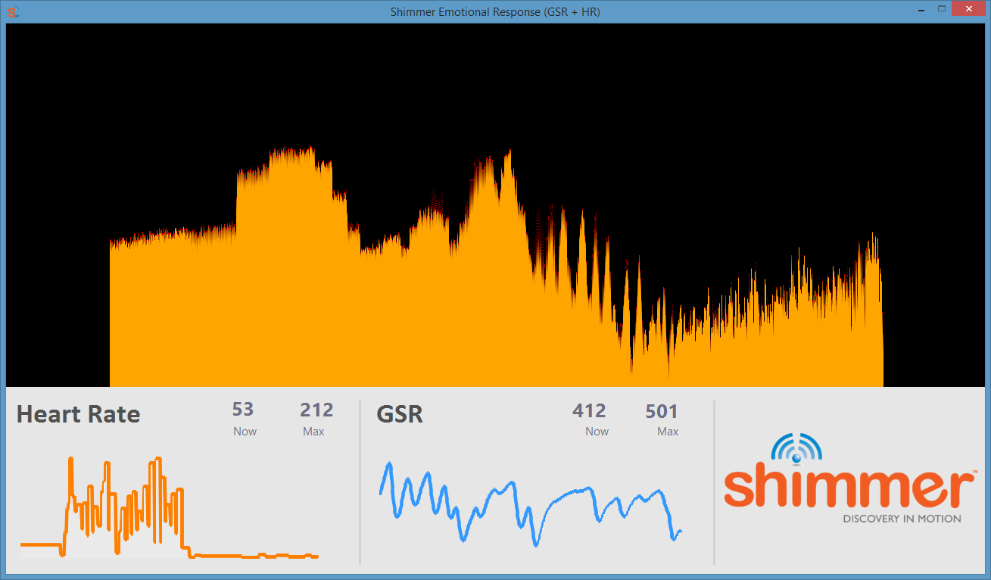
Shimmer GSR Demo
Developed at: Shimmer Research
Platform: Windows (LabVIEW)
Date: 2014
Role: Sole Developer – From Scratch
Marketing demo utilizing GSR and PPG sensor with PPG to heart rate algorithm

Slide 25
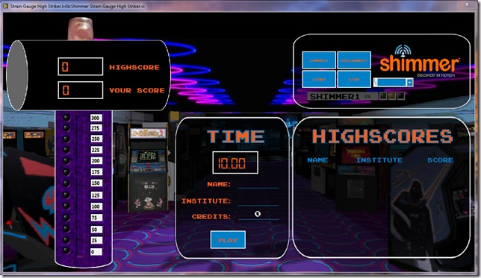
Shimmer Strain Gauge Demo
Shimmer GSR Demo
Developed at: Shimmer Research
Platform: Windows (LabVIEW)
Date: 2014
Role: Sole Developer – From Scratch
Marketing demo utilizing the strain gauge sensor to see who has the strongest grip strength

